Slide 1
Design principles for connected devices

Slide 2
Key terms related to connected devices
1 Layers: The communication between the nodes in a packet data network must be precisely defined to ensure correct interpretation of the packets by the receiving intermediate and the end systems. The packets exchanged between nodes are defined by a protocol - or communications language.
There are many functions which may be need to be performed by a protocol. These range from the specification of connectors, addresses of the communications nodes, identification of interfaces, options, flow control, reliability, error reporting, synchronisation, etc. In practice there are so many different functions, that a set (also known as suite or stack) of protocols are usually defined. Each protocol in the suite handles one specific aspect of the communication.
The protocols are usually structured together to form a layered design (also known as a "protocol stack").
The precise functions in each layer vary.
In each case, however, there is a distinction between the functions of the lower (network) layers, which are primarily designed to provide a connection or path between users to hide details of underlying communications facilities, and the upper (or higher) layers, which ensure data exchanged are in correct and understandable form.
The upper layers are sometimes known as "middleware" because they provide software in the computer which convert data between what the applications programs expect, and what the network can transport.
The transport layer provides the connection between the upper (applications-oriented) layers and the lower (or network-oriented) layers.
The basic idea of a layered architecture is to divide the design into small pieces. Each layer adds to the services provided by the lower layers in such a manner that the highest layer is provided a full set of services to manage communications and run distributed applications.

Slide 3
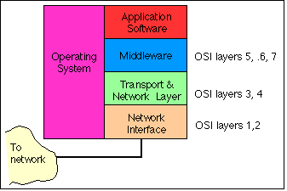

Slide 4
Physical layer
The physical layer is the first layer of the Open System Interconnection Model and refers to a layer at transmitting and receiving stations. The physical layer deals with bit-level transmission between different devices and supports electrical or mechanical interfaces connecting to the physical medium for synchronized communication. This layer plays with most of the network’s physical connections - wireless transmission, cabling, cabling standards and types, connectors and types, network interface cards, and more - as per network requirements.

Slide 5
Application Layer
Application layer is the top most layer in OSI and TCP/IP layered model. This layer exists in both layered Models because of its significance, of interacting with user and user applications. This layer is for applications which are involved in communication system.
A user may or may not directly interacts with the applications. Application layer is where the actual communication is initiated and reflects. Because this layer is on the top of the layer stack, it does not serve any other layers. Application layer takes the help of Transport and all layers below it to communicate or transfer its data to the remote host.
When an application layer protocol wants to communicate with its peer application layer protocol on remote host, it hands over the data or information to the Transport layer. The transport layer does the rest with the help of all the layers below it.

Slide 6
Domain
Domain refers to a set of software , layers or levels specific application and capabilities.
A domain generally has limited interaction with other domain or outside of a domain
E.g., network domain consists of core network, access network, service capabilities

Slide 7
Gateway
A gateway is a hardware device that acts as a "gate" between two networks. It may be a router, firewall, server, or other device that enables traffic to flow in and out of the network.
While a gateway protects the nodes within network, it also a node itself. The gateway node is considered to be on the "edge" of the network as all data must flow through it before coming in or going out of the network. It may also translate data received from outside networks into a format or protocol recognized by devices within the internal network.
A router is a common type of gateway used in home networks. It allows computers within the local network to send and receive data over the Internet.
A firewall is a more advanced type of gateway, which filters inbound and outbound traffic, disallowing incoming data from suspicious or unauthorized sources.
A proxy server is another type of gateway that uses a combination of hardware and software to filter traffic between two networks. For example, a proxy server may only allow local computers to access a list of authorized websites.

Slide 8
IP
An Internet Protocol address (IP address) is a numerical label assigned to each device connected to a computer network that uses the Internet Protocol for communication. An IP address serves two main functions: host or network interface identification and location addressing.
IPv4(32 bits), IPv6(128 bits)

Slide 9
Header
Data header is a broad term for preliminary information that helps prepare an end device for further, more specific information.
header refers to supplemental data placed at the beginning of a block of data being stored or transmitted. In data transmission, the data following the header is sometimes called the payload or body.
The size of the header and its fields are according to the protocol used for creating data stack at a layer.

Slide 10
Packet
A packet is a small amount of data sent over a network, such as a LAN or the Internet. Similar to a real-life package, each packet includes a source and destination as well as the content (or data) being transferred.
Packet size limit is according to the protocol.

Slide 11
Protocol data unit
Protocol data unit (PDU) is a single unit of information transmitted among peer entities of a computer network.
A PDU is composed of protocol specific control information and user data.
In the layered architectures of communication protocol stacks, each layer implements protocols tailored to the specific type or mode of data exchange.
Protocol data units of the OSI model are:
The Layer 4: transport layer PDU is the segment or the datagram.
The Layer 3: network layer PDU is the packet.
The Layer 2: data link layer PDU is the frame.
The Layer1: physical layer PDU is the bit or, more generally, symbol.

Slide 12
Maximum transmission unit
In computer networking, the maximum transmission unit (MTU) is the size of the largest protocol data unit (PDU) that can be communicated in a single network layer transaction.
Larger MTU is associated with reduced overhead.
Smaller MTU values can reduce network delay. In many cases, MTU is dependent on underlying network capabilities and must be adjusted manually or automatically so as to not exceed these capabilities.

Slide 13
For example, the MTU of an Ethernet connection is 1500 bytes. If a system sends packets over an Ethernet network that are larger than 1500 bytes, the data will be fragmented into smaller packets.

Slide 14
Router
A router is a networking device that forwards data packets between computer networks. Routers perform the traffic directing functions on the Internet. Data sent through the internet, such as a web page or email, is in the form of data packets. A packet is typically forwarded from one router to another router through the networks that constitute an internetwork (e.g. the Internet) until it reaches its destination node.
A router is connected to two or more data lines from different IP networks. When a data packet comes in on one of the lines, the router reads the network address information in the packet header to determine the ultimate destination. Then, using information in its routing table or routing policy, it directs the packet to the next network on its journey.

Slide 15
IOT/M2M systems
A number of international organizations have taken action for IOT design standardization. Following are the examples
IETF( International Engineering Task Force, an international ) body initiated actions for addressing and working on the recommendations for the engineering specifications for the internet of things. IETF suggested the specification for the layers and the engineering aspects for the IOT communications, networks and applications

Slide 16
ITU-T( International Telecommunication Union for Telecommunications) suggested a reference model for IOT domain, network and transport capabilities for the IOT services and the application at the application support layers.
ETSI( European Telecommunications Standards Institute) initiated the development of a set of standards for the network, devices and gateway domains for the communication between machines.
OGC( Open Geospatial Consortium), an international Industry Consortium, has also suggested standards for sensors discovery, capabilities, quality and other aspects with support to geographical information web support.

Slide 17
OSI model
The Open Systems Interconnection (OSI) model is an ISO-standard abstract model is a stack of seven protocol layers. From the top down, they are: application, presentation, session, transport, network, data link and physical. TCP/IP, or the Internet Protocol suite, underpins the internet, and it provides a simplified concrete implementation of these layers in the OSI model.

Slide 18
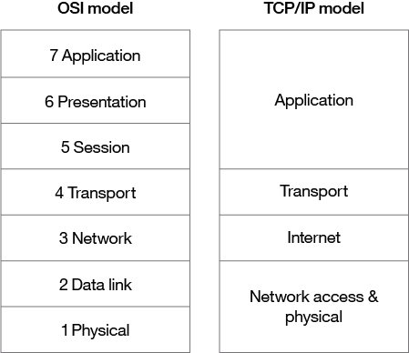
Figure 1. OSI and TCP/IP networking models

Slide 19
Application
= IoT
Applications and Services
Application Support
+ Manage + Acquire + organize
and Analyse
Transport
+ Stream
Network
Data Adaptation
+ Enrich
Physical cum data-link layer
Gather
Fig. 2.1 IETF Six-layer modified-OSI model for IoT/M2M and similarity
_{w201i7th a conceptual}Ch_{f}a_{r}p_{a}te_{m}r-2_{e}L_{w}01_{o}: _{r}"I_{k}nte_{E}rn_{q}et_{u}o_{a}fT_{ti}h_{o}in_{n}gs "_{f},_{o}R_{r}aj_{I}K_{o}a_{T}ma_{A}l,
pps and Services
5
Publs.: McGraw-Hill Education

Slide 20
The figure above shows the ISO reference model and modification suggested by IEFT

Slide 21
Data communicates from device end to application end.
At source end data communicates from Application end (Layer 6) to device-end (Layer 1)
Each layer processes the received data and creates a new data stack which is being transferred to the next layer.
Stack means Data part +protocol header bits/words
The processes takes place at in- between layers from top layer 6 to bottom functional-layer 1 for communication

Slide 22
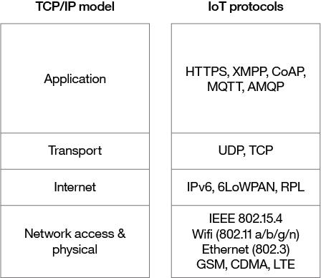

Slide 23
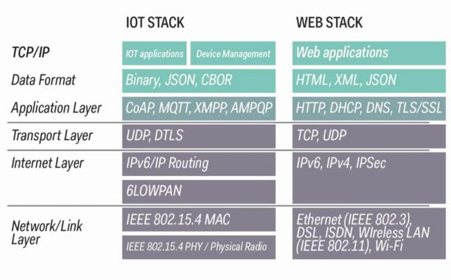

Slide 24
2. ITU-T reference model

Slide 25
Application (Services and Applications capabilities)
Services and Application Support layer (Generic and Specific support capabilities)
Network layer (Transport and Network capabilities)
Device layer (Device and Gateway Capabilities)
ITU-T Reference Model

Slide 26
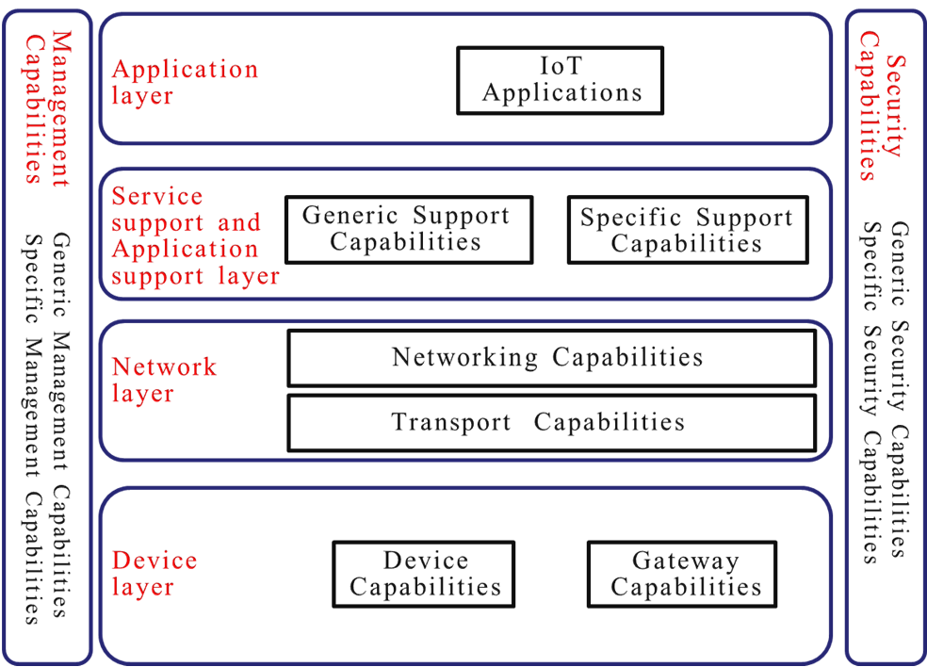

Slide 27
The above figure shows the IoT reference model. It is composed of four layers as well as management capabilities and security capabilities which are associated with the four layers.
The four layers are as follows:
– application layer
– service support and application support layer
– network layer
– device layer.

Slide 28
1 Application layer
The application layer contains IoT applications.
2 Service support and application support layer
The service support and application support layer consists of the following two capability groupings:
– Generic support capabilities: The generic support capabilities are common capabilities which can be used by different IoT applications, such as data processing or data storage.
These capabilities may be also invoked by specific support capabilities, e.g., to build other specific support capabilities.
– Specific support capabilities: The specific support capabilities are particular capabilities which cater for the requirements of diversified applications. In fact, they may consist of various detailed capability groupings, in order to provide different support functions to different IoT applications.

Slide 29
3 Network layer
This consists of the following two types of capabilities:
– Networking capabilities: provide relevant control functions of network connectivity, such as access and transport resource control functions, mobility management or authentication, authorization and accounting (AAA).
– Transport capabilities: focus on providing connectivity for the transport of IoT service and application specific data information, as well as the transport of IoT-related control and management information.

Slide 30
4 Device layer
Device layer capabilities can be logically categorized into two kinds of capabilities:
– Device capabilities: The device capabilities include but are not limited to:
Direct interaction with the communication network: Devices are able to gather and upload information directly (i.e., without using gateway capabilities) to the communication network and can directly receive information (e.g., commands) from the communication network.
Indirect interaction with the communication network: Devices are able to gather and upload information to the communication network indirectly, i.e., through gateway capabilities. Onthe other side, devices can indirectly receive information (e.g., commands) from the communication network.
Ad-hoc networking: Devices may be able to construct networks in an ad-hoc manner in some scenarios which need increased scalability and quick deployment.
Sleeping and waking-up: Device capabilities may support "sleeping" and "waking-up“ mechanisms to save energy.

Slide 31
Gateway capabilities:The gateway capabilities include but are not limited to:
Multiple interfaces support: At the device layer, the gateway capabilities support devices connected through different kinds of wired or wireless technologies, such as a controller area network (CAN) bus, ZigBee, Bluetooth or Wi-Fi. At the network layer, the gateway capabilities may communicate through various technologies, such as the public switched telephone network (PSTN), second generation or third generation (2G or 3G) networks, long-term evolution networks (LTE), Ethernet or digital subscriber lines (DSL).
Protocol conversion: There are two situations where gateway capabilities are needed. One situation is when communications at the device layer use different device layer protocols, e.g., ZigBee technology protocols and Bluetooth technology protocols, the other one is when communications involving both the device layer and network layer use different protocols e.g., a ZigBee technology protocol at the device layer and a 3G technology protocol at the network layer.

Slide 32
Management capabilities
In a similar way to traditional communication networks, IoT management capabilities cover the traditional fault, configuration, accounting, performance and security (FCAPS) classes, i.e., fault management, configuration management, accounting management, performance management and security management.
The IoT management capabilities can be categorized into generic management capabilities and specific management capabilities.
Essential generic management capabilities in the IoT include:
– device management, such as remote device activation and de-activation, diagnostics, firmware and/or software updating, device working status management;
– local network topology management;
– traffic and congestion management, such as the detection of network overflow conditions and the implementation of resource reservation for time-critical and/or life-critical data flows.
Specific management capabilities are closely coupled with application-specific requirements, e.g., smart grid power transmission line monitoring requirements.

Slide 33
Security capabilities
There are two kinds of security capabilities: generic security capabilities and specific security capabilities. Generic security capabilities are independent of applications. They include:
– at the application layer: authorization, authentication, application data confidentiality and integrity protection, privacy protection, security audit and anti-virus;
– at the network layer: authorization, authentication, use data and signalling data confidentiality, and signalling integrity protection;
– at the device layer: authentication, authorization, device integrity validation, access control, data confidentiality and integrity protection.
Specific security capabilities are closely coupled with application-specific requirements, e.g., mobile payment, security requirements.

Slide 34
ETSI reference model

Slide 35
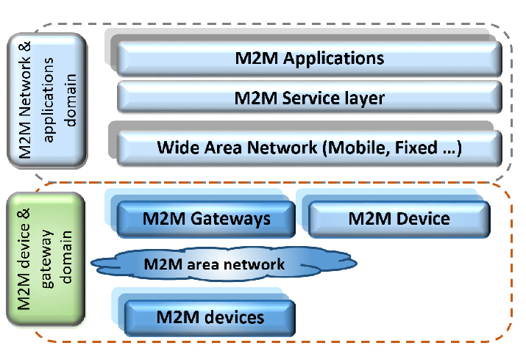

Slide 36
Application
Application and Network Domain (Applications, Management, Service capabilities, and Core and Access Networks)
Application Support
Transport
Network
Device and Gateway Domain [Gateway (M2M Service capabilities, Applications), M2M Area
Network and M2M Devices]
Data Adaptation
Physical cum data- link
Layer
ETSI M2M-domains architecture and its High-level capabilities, and
2t0h1e7ir corresponden^{C}c^{h}eªs^{pt}w^{er-}i²t^{L}h⁰s^{1:}ix^{"In}l^{t}a^{er}y^{n}e^{et}rºs^{f} o^{T}f^{hin}m^{gs}o"d,i^{R}fiªe^{j K}dªO^{ma}S^{l,}I reference model

Slide 37
M2M Device • Device capable of replying to request for data contained within those devices or capable of transmitting data autonomously.
M2M Area Network (Device Domain) •
Provide connectivity between M2M Devices and M2M Gateways, e.g. personal area network.
M2M Gateway • Uses M2M capabilities to ensure M2M Devices inter-working and interconnection to the communication network.
M2M Communication Networks (Network Domain)
• Communications between the M2M Gateway(s) and M2M application(s), e.g. xDSL, LTE, WiMAX, and WLAN.
M2M Applications • Contains the middleware layer where data goes through various application services and is used by the specific business-processing engines.

Slide 38
ETSI M2M has adopted a RESTful architecture style
• Information is represented by resources which are structured as a tree.
ETSI M2M standardizes the resource structure that resides on an M2M Service Capability Layer (SCL)
• Each SCL contains a resource structure where the information is kept.
M2M Application and/or M2M Service Capability Layer exchange information by means of these resources over the defined reference points
ETSI M2M standardizes the procedure for handling the resources

